Slide 1

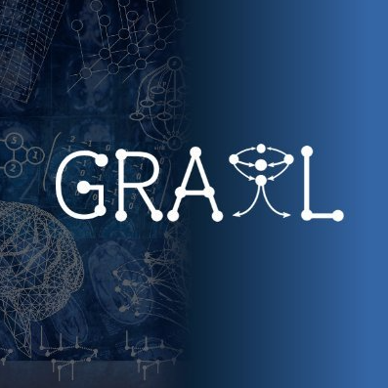
Skip priors and add graph-based anatomical information, for point-based Couinaud segmentation
Xiaotong Zhang, Alexander Broersen, Gonnie CM van Erp, Silvia L. Pintea, Jouke Dijkstra
Radiology Department, Leiden University Medical Center

Slide 2
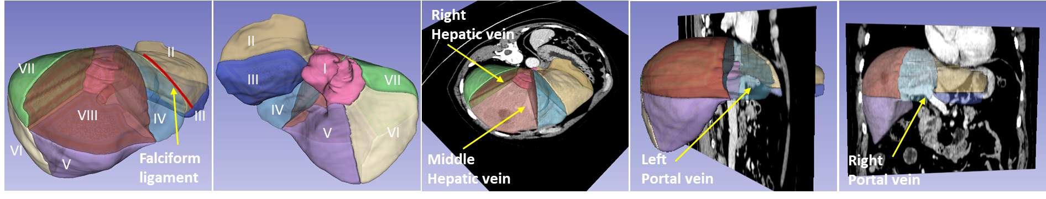
Introduction
Background & Importance:
Couinaud segmentation divides the liver into 8 independent functional segments with distinct vascular inflow and outflow.
Couinaud segmentation is essential for liver resection and also used in liver ablation procedures.
Challenges:
It is inherently a vessel-dependent task.
Manual annotation of liver vessels is highly time-consuming.
Pre-trained models for vessel segmentation may introduce substantial errors.
Our Motivation:
Skipping vessel priors may enhance both clinical reliability and efficiency in Couinaud segmentation.

Slide 3
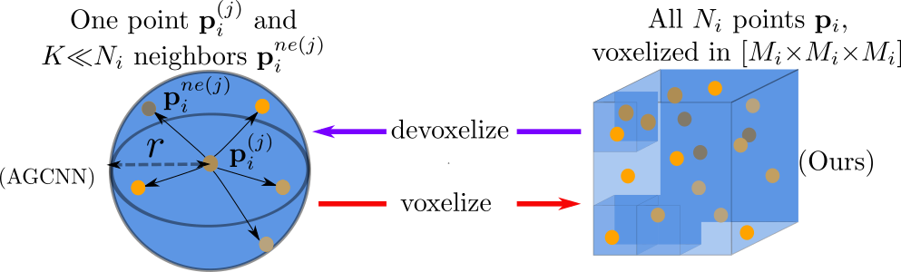
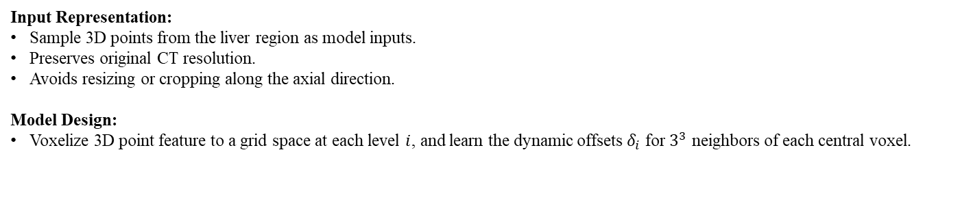


Method
[1]
Input Representation:
Sample 3D points from the liver region as model inputs.
Preserves original CT resolution.
Avoids resizing or cropping along the axial direction.
Model Design:
Voxelize 3D point feature to a grid space at each level $i$, and learn the dynamic offsets $δ_{i}$ for $3^{3}$ neighbors of each central voxel.
$${\hat{p}}_{i}=softmax(q_{i}∙∆\left(k_{i},δ_{i}\right)+{pos}_{i})∙∆(v_{i},δ_{i})$$
where $δ_{i}=Linear(f(p_{i}))$, $δ_{i}∈ℝ^{3×3^{3}}$, $∆(∙,δ_{i})$ is a deformable unfold layer, ${pos}_{i}∈ℝ^{3^{3}}$are the positional embeddings for the query $q_{i}$.
Key Advantage:
Avoids the heavy computation of fully connected affinities across all voxels.
Learnable neighbor offsets around each central voxel enable modeling of irregular grid structures.
[1] Wei, M., Wei, Z., Zhou, H., Hu, F., Si, H., Chen, Z., Zhu, Z., Qiu, J., Yan, X., Guo, Y. and Wang, J., 2023. AGConv: Adaptive graph convolution on 3D point clouds. IEEE Transactions on Pattern Analysis and Machine Intelligence, 45(8), pp.9374-9392.

Slide 4
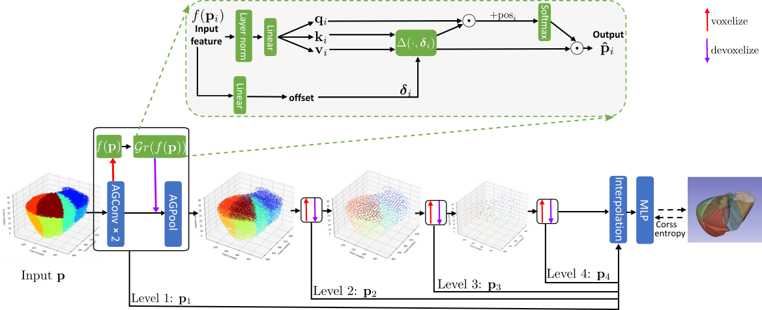
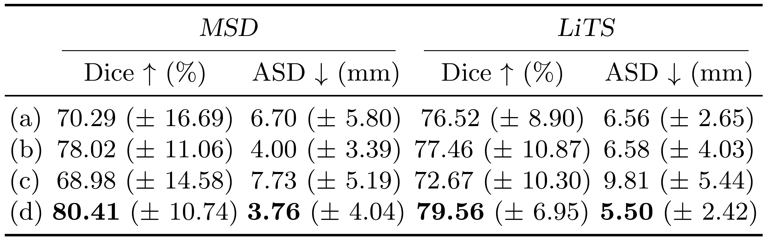
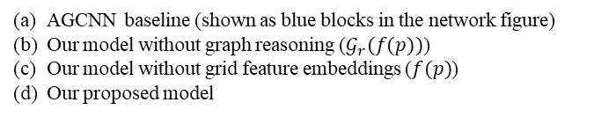
Network architecture
Model ablation:
AGCNN baseline (shown as blue blocks in the network figure)
Our model without graph reasoning ($𝒢_{r}(f(p))$)
Our model without grid feature embeddings ($f(p)$)
Our proposed model

Slide 5
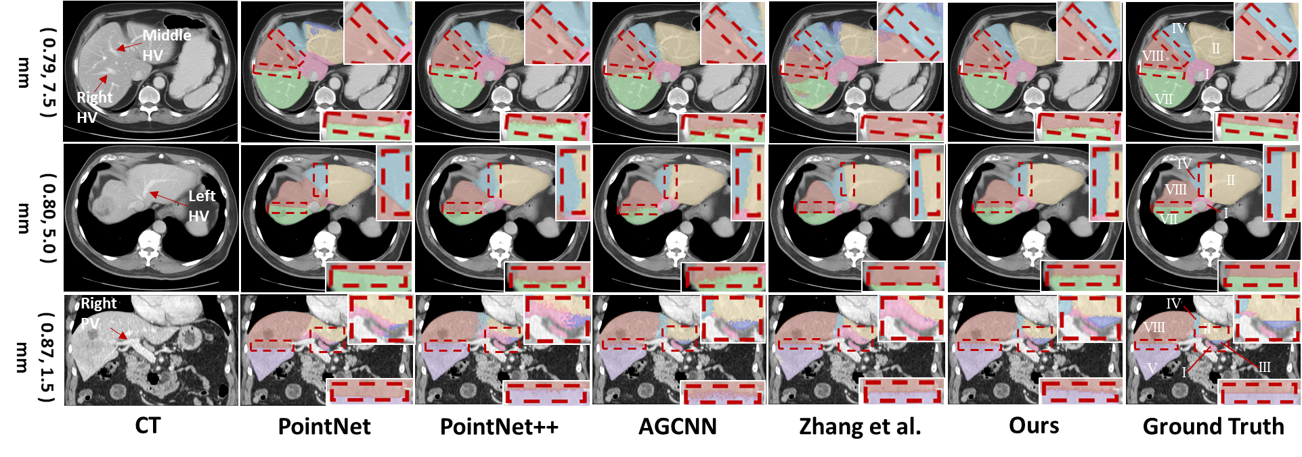
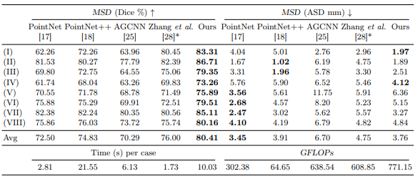
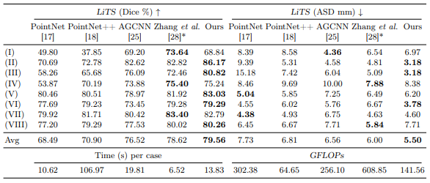
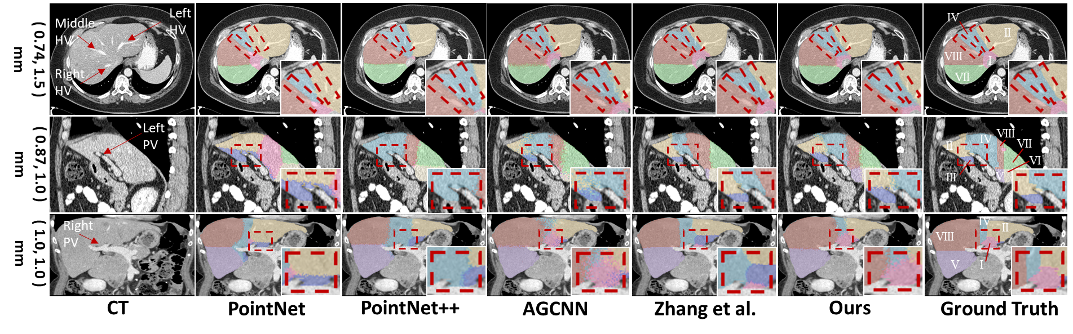
Experimental results

Slide 6
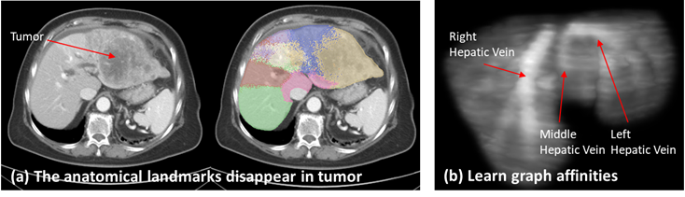
Conclusion and limitations
We propose a 3D point-based model that incorporates anatomical information implicitly, by learning graph affinities between voxels.
Experimental results show that our method is competitive compared to the other point-based methods with or without a liver vessel prior.
Limitations:
The proposed method cannot accurately discriminate segments in the liver when large tumors are present.

Slide 7
Thanks

